Slide 1
Ambulance Alerting System
Team Members: | Sairaj Alave
 | Tanish Bodekar
Guide Name: | Prof. Varalakshmi Rajen
Project Name: | Ambulance Alerting System

Slide 2
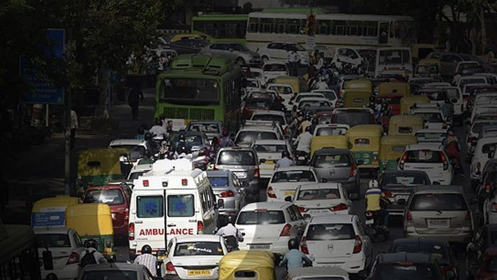
Project Statement:
It is a common sight at busy traffic junctions where ambulances struggles to find a way to carry patients for treatment during the golden hours. Employing an system that can send an ambulance coming information to the traffic police, so he can able to give path.Which help ambulance to reach hospital early.

Slide 3
Abstract
Ambulance is used to take the patient to the hospital as early as possible. But in the high populated city or high traffic city, some ambulance struck at the traffic that is unnoticed by the traffic police to make a way for it. Taking the patients early to the hospital will increase the probability of the life of the patient. We need some technology or system that send the information to the traffic police regarding the ambulance is coming in this route so they can make the way for it and ambulance can able to reach the hospital early. To solve this we introduce a Ambulance Alerting System which will able to send the ambulance information to the traffic police.

Slide 4
Motivation
Taking the patient to the hospital as early as possible can able to safe the life of the patient. Ambulance plays an important role in taking the patients to the hospital. But the traffic in the high traffic city struck the ambulance in the traffic. A report published in Times of India about 146,133 people were killed in road accidents in india in the year 2016. Unfortunately about 30% of deaths are caused due to delayed ambulance. Another Indian government data shows more than 50% of heart attack patients reach hospital late, which can constitute unavailability of ambulances too but majority of its is due to patients stucks in traffic. It motivated us to do the Ambulance alerting system.

Slide 5
Concept
Application interacting person | How users interacting with our project? | How Application responds back?
Ambulance Driver | Ambulance Driver can able to see the near by hospitals and able to enter current and destination location Able to see the direction to the destination | Application shows the best hospital to go fast and it need show based on the availability of the bed and the doctor in the hospital It shows the number of signal in between and send the message to the traffic police to clear the traffic in those signals It need to send the information to the required hospital in the destination location.
Traffic Police | Need to clear the traffic in the ambulance travelling road to make ambulance reach the hospital early If the traffic is high traffic police need to send the road is busy message to the ambulance drive so the ambulance drive choose the alternative road | Send the details about the ambulance travelling road details to make them free by the traffic police Send the high traffic details so that the ambulance can take the alternative path
Hospital | They need to get the patient detials and make the first aid ready and the bed ready for the patient They need to send message if the hospital is full so the ambulance driver can take the patient to the next available hospital | Send the details about the patient to the hospital Send the bed availability details to the ambulance driver

Slide 6
Use of Technology
Tools |  | Usage in this project
Front-End |  | Visual content that appear in the screen
1 | HTML | Used to display the content in the webpage
2 | CSS | Used to style the webpage
3 | JavaScript | Used to make website functionable
Back-End |  | Process the instruction
1 | Python | The back-end code is written in Python
2 | Flask | Flask is the framework of python that serve front-end
3 | MySQL | Used to store data
ngrok |  | Used to serve the localhost to internet
Tools |  | Usage in this project
MapMyIndia |  | Map tool
1 | MapMyIndia Direction Plugin | Used to give direction to the ambulance driver
2 | MapMyIndia Nearyby Search Plugin | Used to give nearby hospital to ambulance driver
Discord |  | Discord message app
1 | Discord Server | Used to send and receive message in the discord app
2 | Discord Web hook | Used to send message from python to the discord server

Slide 7

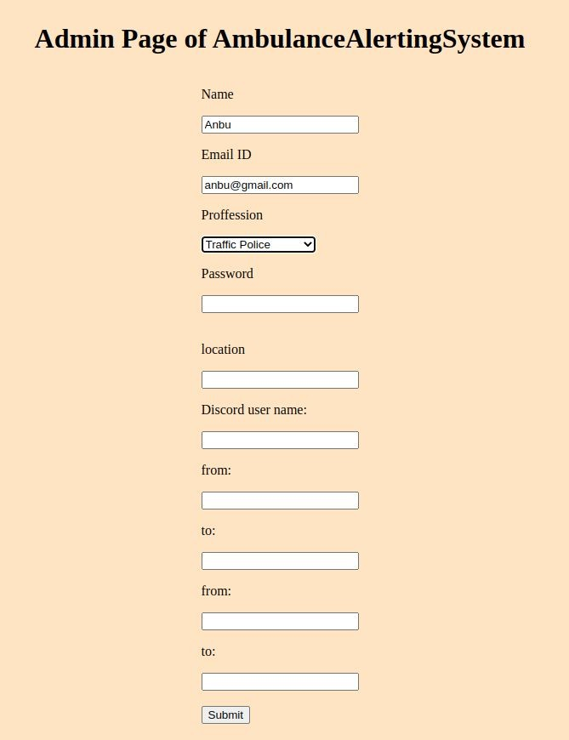


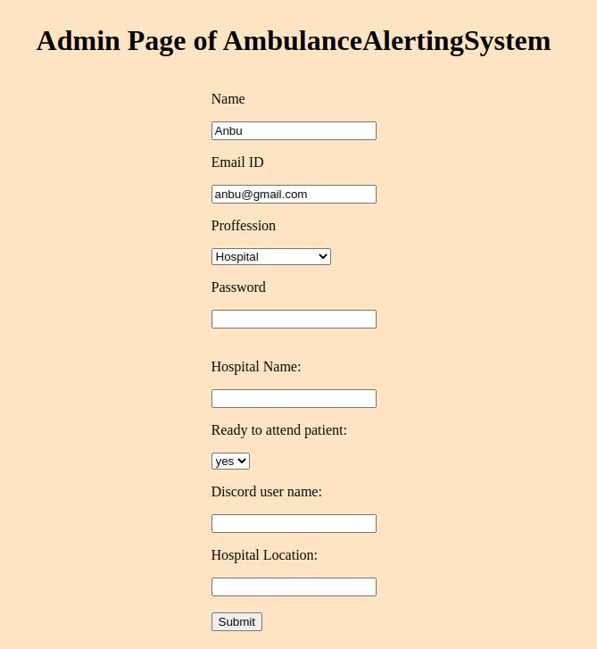
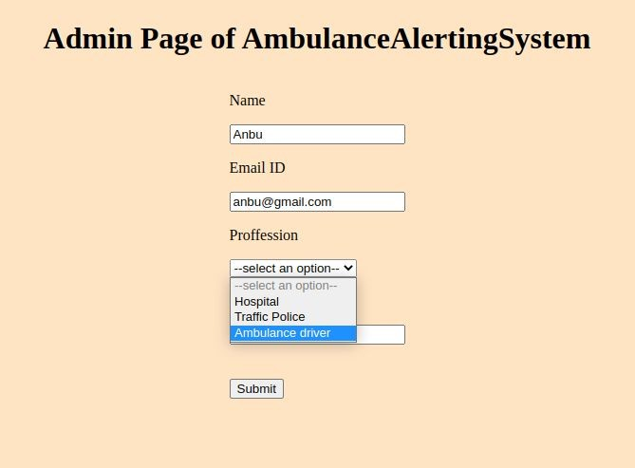
Working - Admin

Slide 8
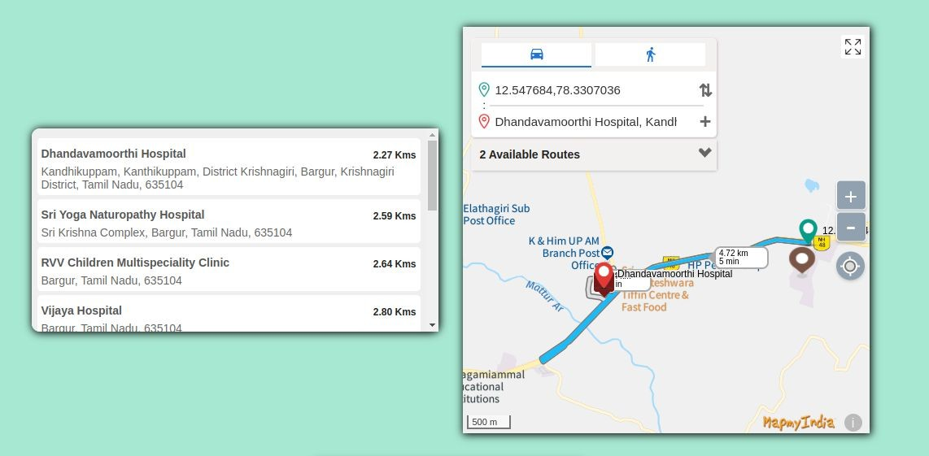
Working - Ambulance driver page

Slide 9
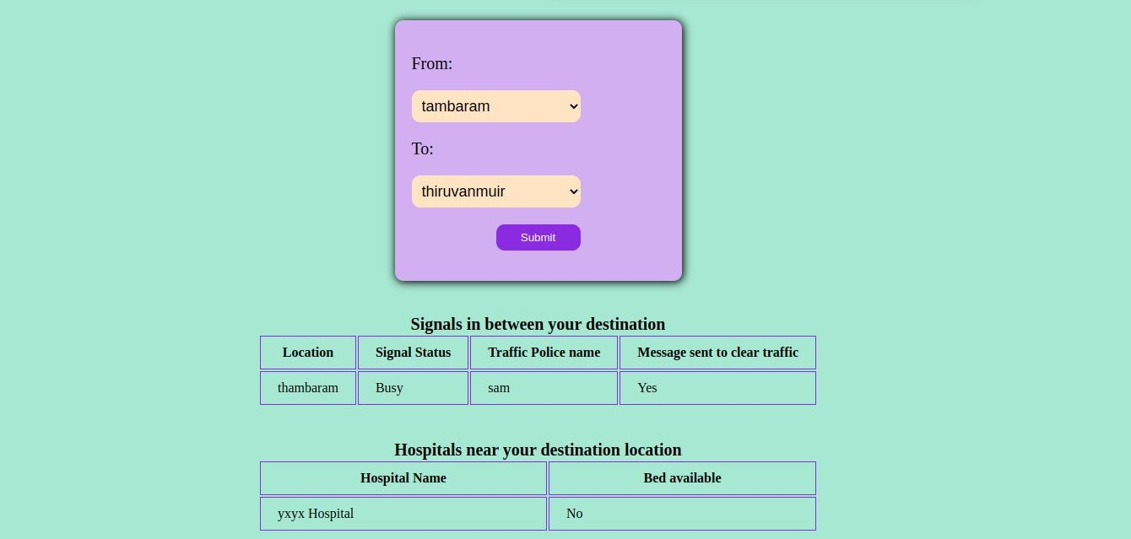
Working

Slide 10
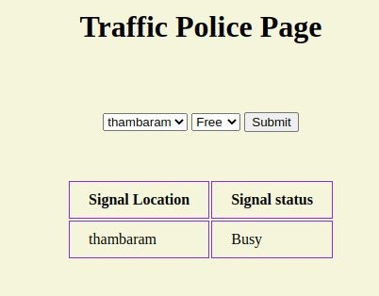
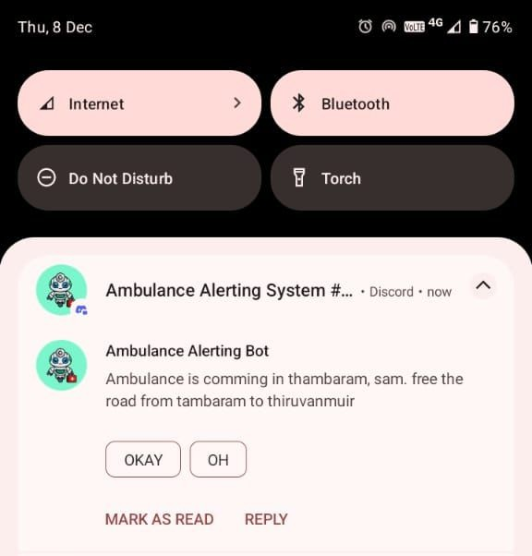
Working - Traffic police page

Slide 11
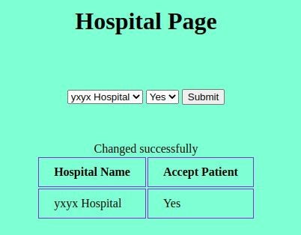
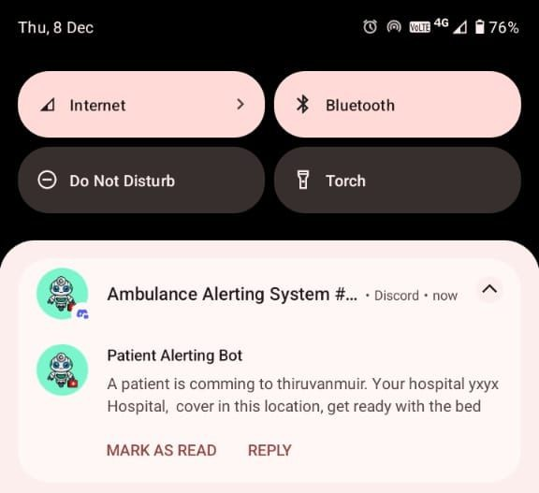
Working - hospital page

Slide 12
Future Scope & Conclusion
The Ambulance Alert System has significant potential for future expansion and enhancement through the integration of advanced technologies. As cities continue to grow and traffic congestion worsens, improving emergency response systems will become even more critical.
1. AI-Powered Route Optimization
2. Integration with Smart City Infrastructure
3. Vehicle-to-Vehicle (V2V) Communication
4. Expansion to Rural and Remote Areas
5. Public Awareness and Mobile App Integration
The Ambulance Alert System is a transformative approach to improving emergency response times by leveraging real-time tracking, smart route optimization, and automated hospital communication. By integrating traffic signal preemption and AI-based decision-making, the system ensures that ambulances can navigate through congested urban areas efficiently, ultimately saving lives.

Slide 13
Thank you

